Slide 1
IoT Reference Model

Slide 2
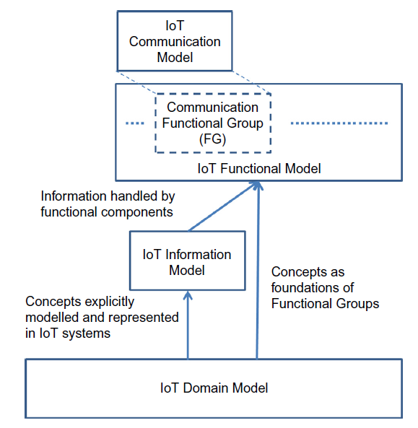
IoT Reference Model
An ARM consists of two main parts: a Reference model and a Reference Architecture.

Slide 3
The foundation of an IoT Reference Architecture description is an IoT reference model. A reference model describes the domain using a number
of sub-models ( in Figure). The domain model of an architecture model captures the main concepts or entities in the domain in question, in this case M2M and IoT.
When these common language references are established, the domain model adds descriptions about the relationship between the concepts. These concepts and relationships serve the basis for the development of an information model because a working system needs to capture and process information about its main entities and their interactions.

Slide 4
A working system that captures and operates on the domain and information model contains concepts and entities of its own, and these need to be described in a separate model, the functional model.
An M2M and IoT system contain communicating entities, and therefore the corresponding communication model needs to capture the communication interactions of these entities.

Slide 5
A System Architecture is a communication tool for different stakeholders of the system. Developers, component and system managers, partners, suppliers, and customers have different views of a single system based on their requirements and their specific interactions with the system. As a result, describing an architecture for M2M and IoT systems involves the presentation of the multiple facets of the systems
in order to satisfy the different stakeholders
A Reference Architecture captures the essential parts of an architecture, such as design principles, guidelines, and required parts (such as entities), to monitor and interact with the physical world for the case of an IoT Reference Architecture

Slide 6
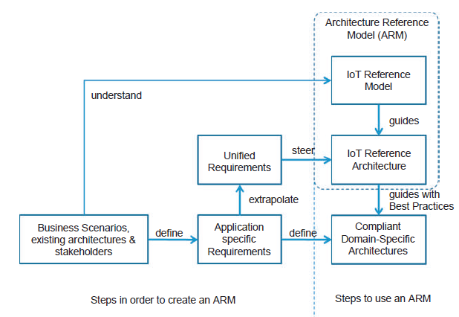

Slide 7
IoT domain model
A domain model defines the main concepts of a specific area of interest, in this case the IoT. These concepts are expected to remain unchanged over the course of time, even if the details of an ARM may undergo continuous transformation or evolution over time. The domain model captures the basic attributes of the main concepts and the relationship between these concepts. A domain model also serves as a tool for human communication between people working in the domain in question and between people who work across different domains.

Slide 8
Model notation and semantics
For the purposes of the description of the domain model, we use the Unified Modeling Language (UML)
Class diagrams in order to present the relationships between the main concepts of the IoT domain model. The Class diagrams consist of boxes that represent the different classes of the model connected with each other through typically continuous lines or arrows, which represent relationships between the respective classes. Each class is a descriptor of a set of objects that have similar structure, behavior, and relationships

Slide 9
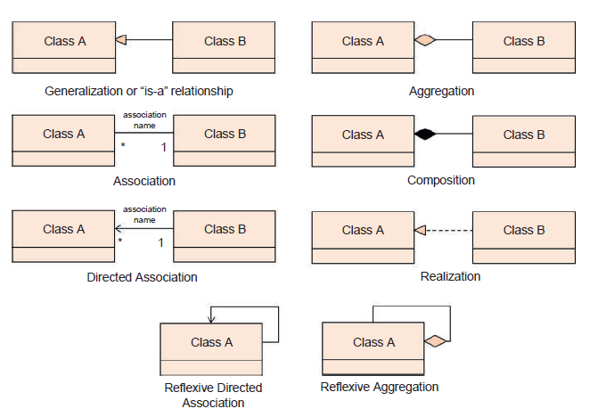

Slide 10
IoT Domain Model: Generalization/ Specialization, Aggregation and Reflexive Aggregation, Composition, Directed Association and Reflexive Directed Association, and Realization.
The Generalization/Specialization relationship is represented by an arrow with a solid line and a hollow triangle head. Depending on the starting
point of the arrow, the relationship can be viewed as a generalization or specialization.
For example, in Figure Class A is a general case of
Class B or Class B is special case or specialization of Class A.

Slide 11
Generalization is also called an “is-a” relationship.
For example, in Figure Class B “is-a” Class A. A specialized class/subclass/child class inherits the attributes and the operations from the general/super/parent class, respectively, and also contains its own attributes and operations.

Slide 12
The Aggregation relationship is represented by a line with a hollow diamond in one end and represents a whole-part relationship or a containment
relationship and is often called a “has-a” relationship. The class that touches the hollow diamond is the whole class while the other class is the
part class.
For example, in Figure class B represents a part of the whole Class A, or in other words, an object of Class A “contains” or “has-a” object of Class B. When the line with the hollow diamond starts and ends in the same class, then this relationship of one class to itself is
called Reflexive Aggregation, and it denotes that objects of a class (e.g. Class A in Figure) contain objects of the same class.

Slide 13
The Composition relationship is represented by a line with a solid black diamond in one end, and also represents a whole-part relationship or a containment relationship. The class that touches the solid black diamond is the whole class while the other class is the part class.
For example, in Figure , Class B is part of Class A. Composition and Aggregation are very similar, with the difference being the coincident lifetime to the
objects of classes related with composition. In other words, if an object of Class B is part of an object of Class A (composition), when the object of Class A disappears, the object of Class B also disappears.

Slide 14
A plain line without arrowheads or diamonds represents the
Association relationship.
The Directed Association implies navigability from a Class B
to a Class A in Figure 7.4. Navigability means that objects of Class B have the necessary attributes to know that they relate to objects of Class A while the reverse is not true: objects of Class A can exist without having references to objects of Class B.
When the arrow starts and ends at the same class, then the class is associated to itself with a Reflexive Directed
Association, which means that an object of this class (e.g. Class A in Figure ) is associated with objects of the same class with the specific named association.

Slide 15
An arrow with a hollow triangle head and a dashed line represents the Realization relationship.
This relationship represents a association between
the class that specifies the functionality and the class that realizes the functionality.
For example, Class A in Figure specifies the functionality while Class B realizes it.

Slide 16
UML class diagram is used to present the relationship between the concepts.
Set of operations section is not used IoT domain model description
Relationships
Association/Directed association
Generalization or specialization
Aggregation
Composition
Reflexive
Realization
Dependency

Slide 17
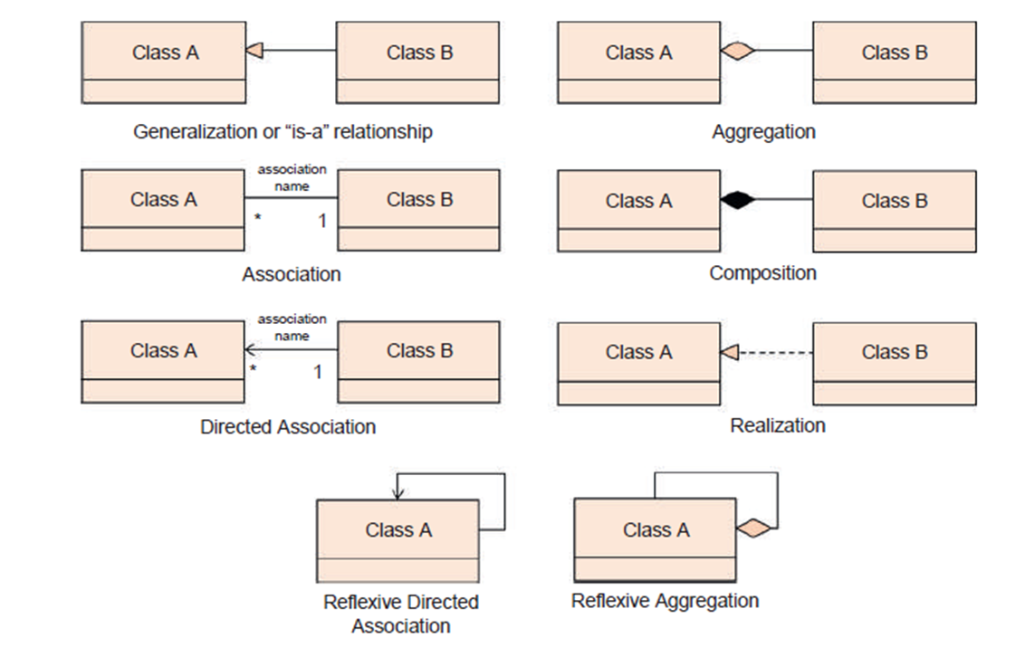

Slide 18
Imagine that we are interested in monitoring a parking lot with 16 parking spots. The parking lot includes a payment station for drivers to pay for the parking spot after they park their cars. The parking lot also includes an electronic road sign on the side of the street that shows in real-time the
number of empty spots. Frequent customers also download a smart phone application that informs them about the availability of a parking spot before they even drive on the street where the parking lot is located.

Slide 19
In order to realize such a service, the relevant physical objects as well as their properties need to be captured and translated to digital objects such as variables, counters, or database objects so that software can operate on these objects and achieve the desired effect, i.e. detecting when someone parks without paying, informing drivers about the availability of parking spots, producing statistics about the average occupancy levels of the parking lot, etc. For these purposes, the parking lot as a place is instrumented with parking spot sensors (e.g. loops), and for each sensor, a digital representation is created (Parking spot #1#16). In the digital world, a parking spot is a variable with a binary value (“available” or “occupied”).

Slide 20
The parking loT payment station also needs to be represented in the digital world in order to check if a recently parked car owner actually paid the parking fee. Finally, the availability sign is represented to the digital world in order to allow notification to drivers that an empty lot is full for maintenance purposes, or even to allow maintenance personnel to detect when the sign is malfunctioning.

Slide 21
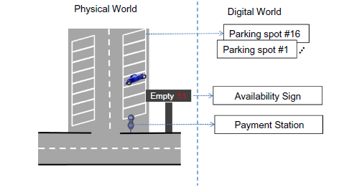
Main Concepts

Slide 22
Physical Entity
Virtual Entity
User
Digital artifact
IoT Device(sensor or actuators)

Slide 23
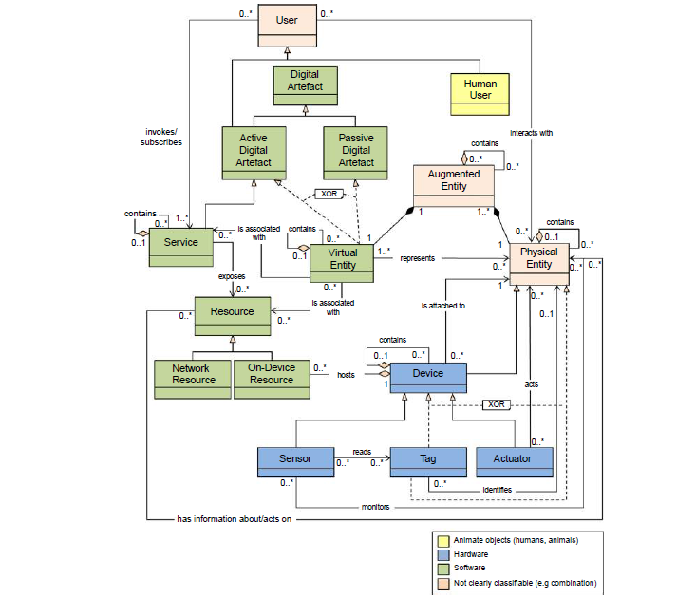

Slide 24

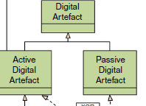

Slide 25
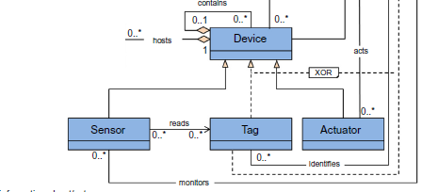

Slide 26
Sensors: These are simple or complex Devices that typically involve a transducer that converts physical properties such as temperature into electrical signals.
Actuators: These are also simple or complex Devices that involve a transducer that converts electrical signals to a change in a physical property (e.g. turn on a switch or move a motor).
Tags: Tags in general identify the Physical Entity that they are attached to. In reality, tags can be Devices or Physical Entities but not both, as the domain model shows. An example of a Tag as a Device is a Radio Frequency Identification (RFID) tag, while a tag as a Physical Entity is a paper-printed immutable barcode or Quick Response (QR) code.

Slide 27
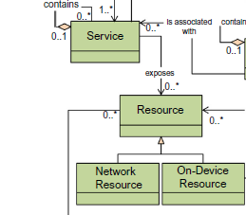

Slide 28
Information Model
According to the Data Information Knowledge Wisdom Pyramid (Rowley 2007), information is defined as the enrichment of data (raw values without relevant or usable context) with the right context, so that queries about who, what, where, and when can be answered. Because the Virtual Entity in the IoT Domain Model is the “Thing” in the Internet of Things, the IoT information model captures the details of a Virtual Entity centric model.

Slide 29
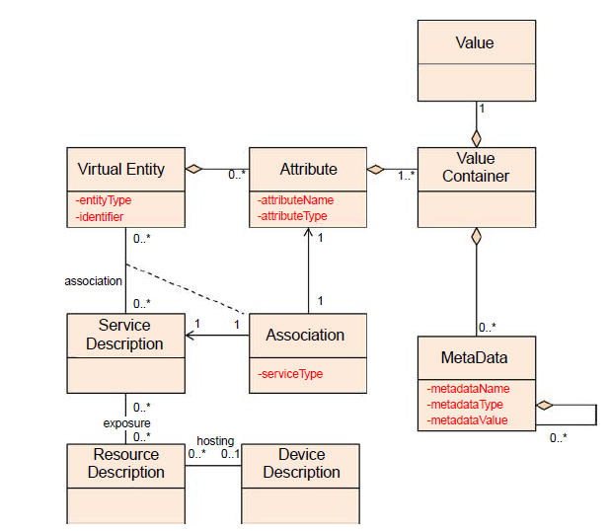
High-level IoT Information Model.

Slide 30
Similar to the IoT Domain Model, the IoT Information Model is presented using Unified Modeling Language (UML) diagrams.
The IoT Information Model maintains the necessary information about Virtual Entities and their properties or attributes.
On a high-level, the IoT Information Model maintains the necessary information about Virtual Entities and their properties or attributes. These
properties/attributes can be static or dynamic and enter into the system in various forms, e.g. by manual data entry or reading a sensor attached to
the Virtual Entity.

Slide 31
Virtual Entity attributes can also be digital synchronized copies of the state of an actuator as mentioned earlier: by updating the value of an Virtual Entity attribute, an action takes place in the physical world.
The IoT Information Model describes Virtual Entities and their attributes that have one or more values annotated with meta-information or metadata. The attribute values are updated as a result of the associated services to a Virtual Entity. The associated services, in turn, are related to Resources and Devices as seen from the IoT Domain Model.

Slide 32
A Virtual Entity object contains simple attributes/properties:
(a) Entity Type to denote the type of entity, such as a human, car, or room (the entity type can be a reference to concepts of a domain ontology, e.g. a car
ontology);
(b) a unique identifier; and
(c) zero or more complex attributes of the class Attributes. The class Attributes should not be confused with the simple attributes of each class. This class Attributes is used as a grouping mechanism for complex attributes of the Virtual Entity

Slide 33
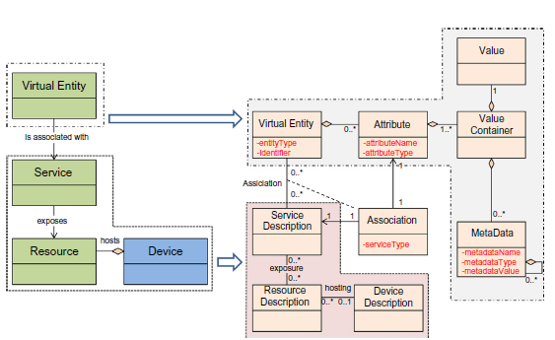
Relationship between core concepts of IoT Domain Model and IoT Information Model.

Slide 34
IoT Functional model
The IoT Functional Model aims at describing mainly the Functional Groups (FG) and their interaction with the ARM, while the Functional View of a Reference Architecture describes the functional components of an FG, interfaces, and interactions between the components.
The Functional View is typically derived from the Functional Model in conjunction with high level
requirements.

Slide 35
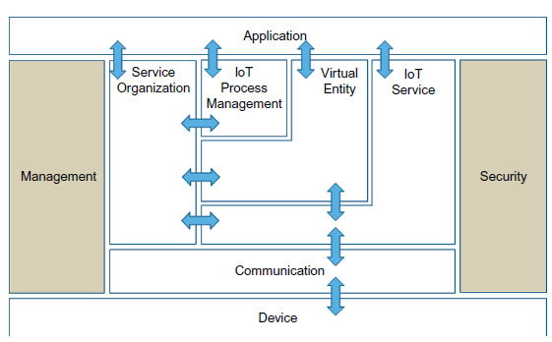

Slide 36
The Application, Virtual Entity, IoT Service, and Device FGs are generated by starting from the User, Virtual Entity, Resource, Service, and Device classes from the IoT Domain Model. The need for communicating
Devices and digital artifacts was the motivation for the Communication FG.
The figure shows the flow of information between FGs apart from the cases of the Management and
Security FGs that have information flowing from/to all other FGs, but these flows are omitted for clarity purposes.

Slide 37
FG- 1 Device functional group
The Device FG contains all the possible functionality hosted by the physical Devices that are used for instrumenting the Physical Entities.
This Device functionality includes sensing, actuation, processing, storage, and identification components, the sophistication of which depends on the Device capabilities.

Slide 38
FG-2 Communication functional group
The Communication FG abstracts all the possible communication mechanisms used by the relevant Devices in an actual system in order to transfer information to the digital world components or other Devices.
Examples of such functions include wired bus or wireless mesh technologies through which sensor
Devices are connected to Internet Gateway Devices.

Slide 39
FG-3 IoT Service functional group
The IoT Service FG corresponds mainly to the Service class from the IoT Domain Model, and contains single IoT Services exposed by Resources hosted on Devices or in the Network (e.g. processing or storage Resources).
Support functions such as directory services, which allow discovery of Services and resolution to Resources, are also part of this FG.

Slide 40
FG-4 Virtual Entity functional group
The Virtual Entity FG corresponds to the Virtual Entity class in the IoT Domain Model, and contains the necessary functionality to manage associations
between Virtual Entities with themselves as well as associations between Virtual Entities and related IoT Services, i.e. the Association objects for the IoT Information Model.
An example of a dynamic association between Virtual Entities is a car moving from one block of a city to another (the car is one Virtual Entity
while the city block is another). A major difference between IoT Services and Virtual Entity Services is the semantics of the requests and responses
to/from these services.

Slide 41
FG-5 IoT Service Organization functional group
The purpose of the IoT Service Organization FG is to host all functional components that support the composition and orchestration of IoT and
Virtual Entity services.
Moreover, this FG acts as a service hub between several other functional groups such as the IoT Process Management FG when, for example, service requests from Applications or the IoT Process Management are directed to the Resources implementing the necessary Services.

Slide 42
FG-6 IoT Process Management functional group
The IoT Process Management FG is a collection of functionalities that allows smooth integration of IoT-related services (IoT Services, Virtual Entity Services, Composed Services) with the Enterprise (Business) Processes.

Slide 43
FG-7 Management functional group
The Management FG includes the necessary functions for enabling fault and performance monitoring of the system, configuration for enabling the system to be flexible to changing User demands, and accounting for enabling subsequent billing for the usage of the system. Support functions such as management of ownership, administrative domain, rules and rights
of functional components, and information stores are also included in the Management FG.

Slide 44
FG-8 : Security functional group
The Security FG contains the functional components that ensure the secure operation of the system as well as the management of privacy.
The Security FG contains components for Authentication of Users (Applications, Humans), Authorization of access to Services by Users, secure communication (ensuring integrity and confidentiality of messages) between entities of
the system such as Devices, Services, Applications, and last but not least, assurance of privacy of sensitive information relating to Human Users

Slide 45
FG-9 Application functional group
The Application FG is just a placeholder that represents all the needed logic for creating an IoT application. The applications typically contain
custom logic tailored to a specific domain such as a Smart Grid.
An application can also be a part of a bigger ICT system that employs IoT services such as a supply chain system that uses RFID readers to track the movement of goods within a factory in order to update the Enterprise Resource Planning (ERP) system

Slide 46
Communication model
The communication model for an IoT Reference Model consists of the identification of the endpoints of interactions, traffic patterns (e.g. unicast vs. multicast), and general properties of the underlying technologies used for enabling such interactions.
The potential communicating endpoints or entities are the Users, Resources, and Devices from the IoT Domain Model. Users include Human Users and Active Digital Artifacts (Services, internal system components, external applications). Devices with a Human Machine Interface mediate the interactions between a Human User and the physical world
(e.g. keyboards, mice, pens, touch screens, buttons, microphones, cameras, eye tracking, and brain wave interfaces, etc.), and therefore the Human User is not a communication model endpoint.

Slide 47
The User to-Service and Service-to-Service communication is typically based on Internet protocols today as described in Chapter 5, apart from the case of Service-to-Service interactions when one or both Services are hosted
on constrained/low-end Devices such as embedded systems.
Typically, constrained Devices have a different communication stack from the ones used for the Internet-type of networks.
.

Slide 48
Device to host Resources or Services results in moving the corresponding Resources and/or Services out of the Device and into more powerful
Devices or machines in the cloud.
Then the Resource-to-Device or the Service-to-Resource communication needs to involve multiple types of communication stacks

Slide 49
Safety, privacy, trust, security model
An IoT system enables interactions between Human Users and Active Digital Artifacts (Machine Users) with the physical environment.
The fact that Human Users are part of the system that could potentially harm humans if malfunctioning, or expose private information, motivates the Safety and Privacy needs for the IoT Reference Model and Architecture.
The Trust and Security Model are needed in every ICT system with the objective to protect the digital world.

Slide 50
A. Safety
System safety is highly application- or application domain-specific, and is typically closely related to an IoT system that includes actuators that could potentially harm animate objects (humans, animals).
For example, the operation of an IoT system controlling an elevator could harm humans if it allowed the elevator doors to open with a normal user interaction when the elevator room is not behind the doors.
A system designer of such critical systems typically follows
an iterative process with two steps: (a) identification of hazards followed by, (b) the mitigation plan.
This process is very similar to the threat model and mitigation plan that a security designer performs for an ICT system. Not all hazards or mitigation steps include IoT technology, but a system designer could add safety assertions in relevant points in the interaction between Users, Services, Resources, and Devices.

Slide 51
B. Privacy
It depends on the following functional components: Identity Management, Authentication, Authorization, and Trust & Reputation.
Identity Management offers the derivation of several identities of different types for the same architectural entity with the objective to protect the original User identity for anonymization purposes. Authentication is a function that allows the verification of the identity of a User whether this is the original
or some derived identity.
Authorization is the function that asserts and
enforces access rights when Users (Services, Human Users) interact with Services, Resources, and Devices.

Slide 52
C. Trust
According to the Internet Engineering Task Force (IETF) Internet Security Glossary (Shirey 2007), “Generally, an entity is said to ‘trust’ a second entity
when the first entity makes the assumption that the second entity will behave exactly as the first entity expects.”
This definition includes an “expectation” which is difficult to capture in a technical context.

Slide 53
D. Security
The Security Model for IoT consists of communication security that focuses mostly on the confidentiality and integrity protection of interacting
entities and functional components such as Identity Management, Authentication, Authorization, and Trust & Reputation.

